Slide 1
Designing a Talend standard Job
February 15, 2018
Presenter:

Slide 2
Logs & Error Handling

Slide 3
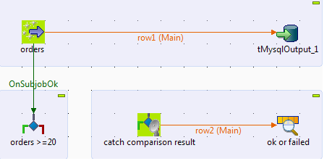
tAssert
The tAssert component works alongside tAssertCatcher to evaluate the status of a Job execution.

Slide 4
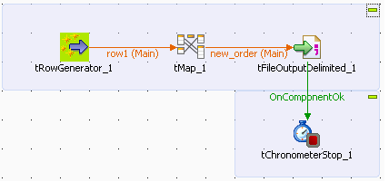
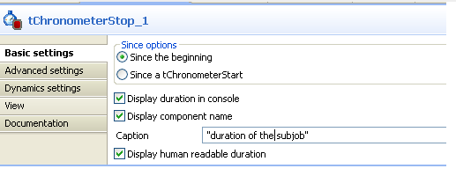
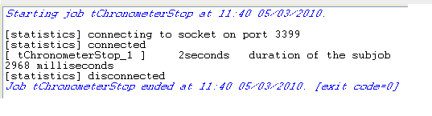
tChronometerStop
Measures the time a subjob takes to be executed.

Slide 5
tDie and tWarn
tDie:- This component throws an error and kills the job.
tWarn:- This component provides a priority-rated message to the next component. It does not stop your Job in case of error.

Slide 6
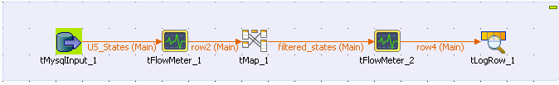
tFlowMeter
Counts the number of rows processed in the defined flow.

Slide 7

tLogRow
Displays data or results in the Run console.
tLogRow is used to monitor data processed.

Slide 8
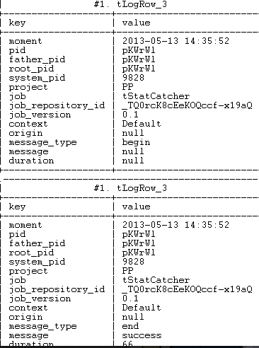
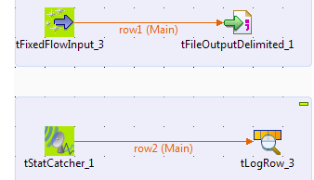
tStatCatcher
Based on the pre-defined schema, tStatCatcher gathers the Job processing metadata at the Job level and at the component level when the tStatCatcher Statistics check box is selected.
Gathers the Job processing metadata at the Job level and at the component level when the tStatCatcher Statistics check box is selected and transfers the log data to the subsequent component for display or storage.

Slide 9
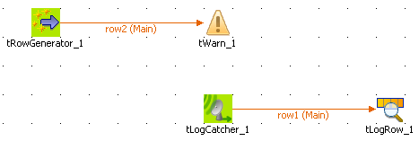
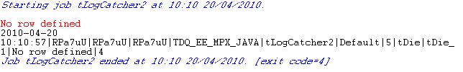
tLogCatcher
Fetches set fields and messages from Java Exception, tDie and/or tWarn and passes them on to the next component.

Slide 10
Questions?
Copyright © 2014 by Vikram Takkar. All Rights Reserved..

